Slide 1
Outbox
Transactional Messaging w. examples in .NET
@ICooper

Slide 2
Who are you?
Software Developer for more than 25 years
Stuff I care about: Messaging, EDA, Microservices, TDD, XP, OO, RDD & DDD, Code that Fits in My Head, C#
Places I have worked: DTI, Reuters, Sungard, Beazley, Huddle, Just Eat Takeaway
No smart folks
Just the folks in this room

Slide 3
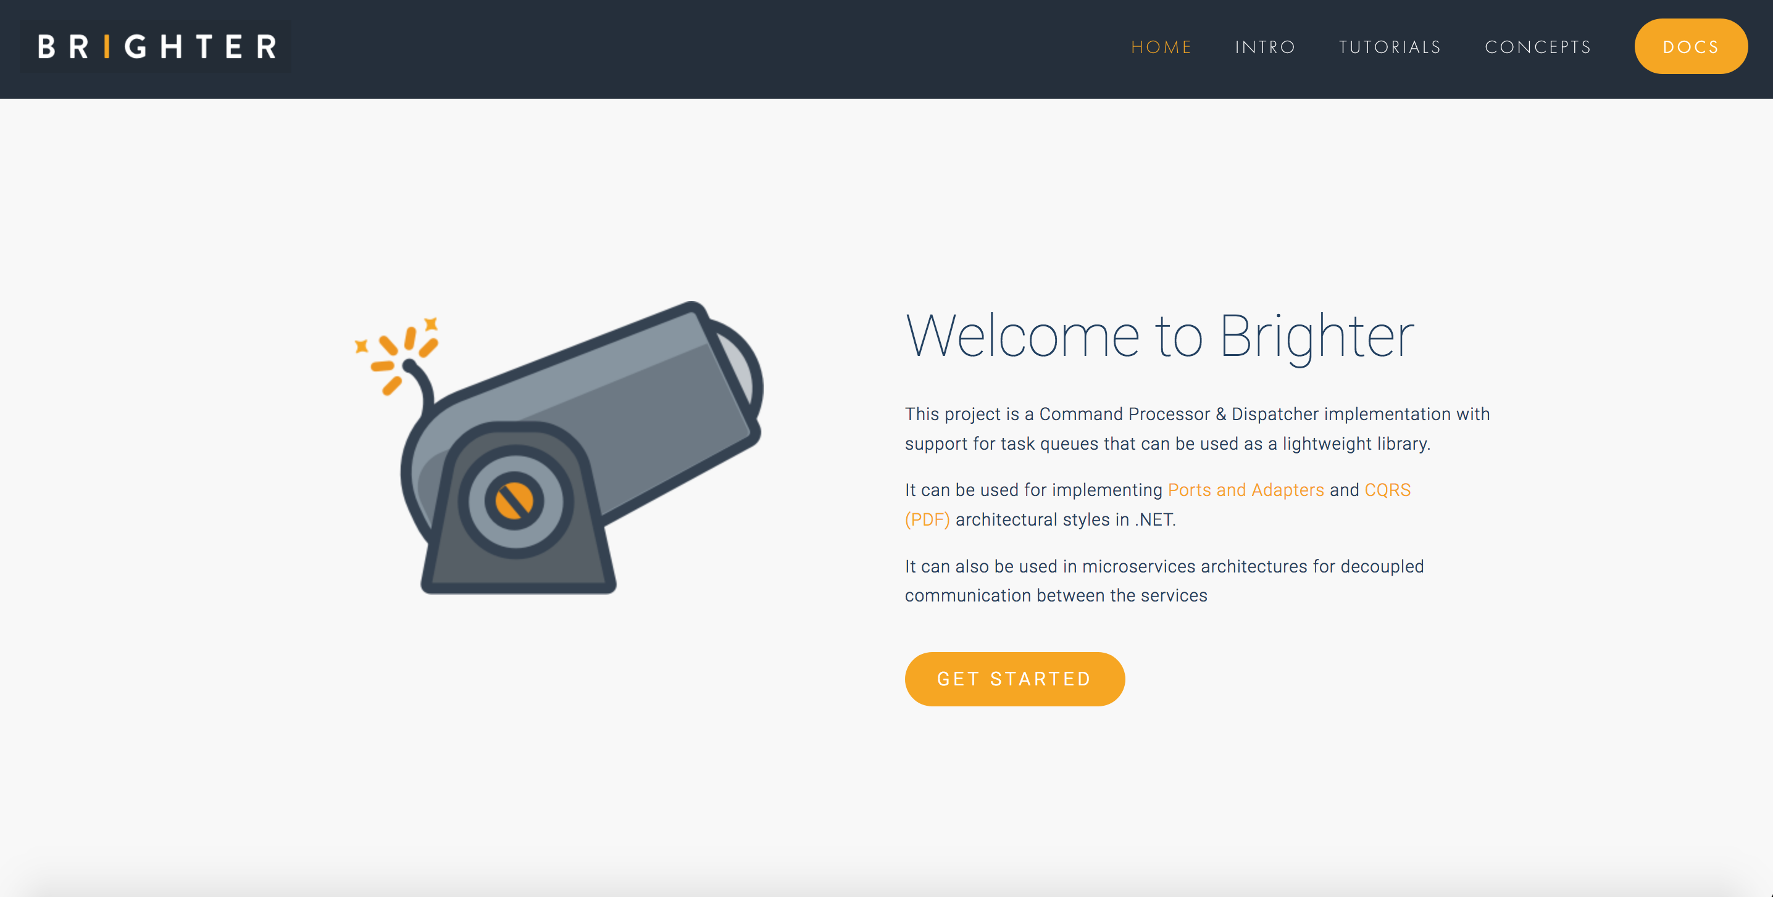

Slide 4
Agenda
Messaging: Outbox and Inbox
Brighter Example

Slide 5
Agenda
T:40
Messaging: Outbox and Inbox
Brighter Example

Slide 6
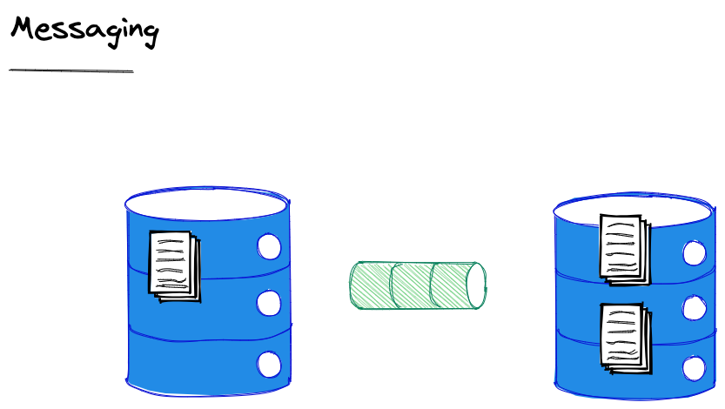
We do not use synchronous communication – which implies holding open a transaction for a response – to update multiple entities. We use messaging.
Notes:
Because we cannot have a transaction spanning two entities we do not use synchronous communication – which implies holding open a transaction for a response – to update multiple entities
“If you can’t update the data across two entities in the same transaction, you need a mechanism to update the data in different transactions. The connection between the entities is via a message.”
Method calls are typically synchronous with respect to the calling thread. They are also synchronous with respect to the calling object’s transaction. While the called object may or may not be atomically coupled with the calling object, the typical method call does not
atomically record the intent to invoke a message and guarantee the at-least-once invocation of the called message. Some systems wrap message-sending into a method call and I consider those to be messages, not methods.

Slide 7
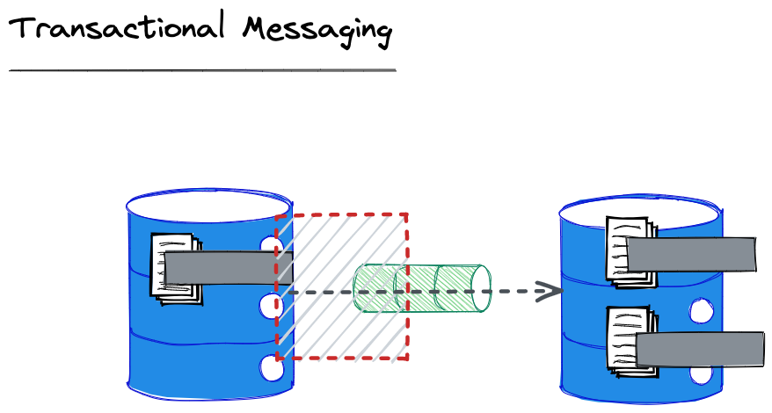
We must ensure that the message is enqueued using a transaction with the entity change, otherwise the other entity will become inconsistent because no message was sent!

Slide 8
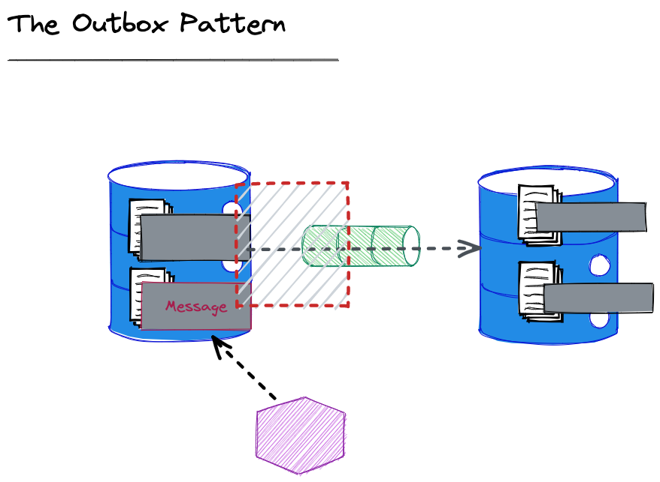
We can also send the message written immediately from the application to reduce latency (caused by the polling interval for the worker).
We are unable to create a transaction between Db and queue
We create an Outbox table and write the message we intend to send to that, in a transaction with the write with the changed/added entity
A worker looks for messages that have not been marked as sent, and sends them. It will retry until sent.
Notes:
This slide isn’t about Pat’s paper, it’s a pattern to solve the conundrum of enqueuing the message in the same transaction as the entity posed by Pat, in the absence of a transaction across queue and database.

Slide 9
We can’t know if our failure to receive an ack from the broker that a message was sent means it actually was not sent.
For this reason although we offer guaranteed delivery it is at least once, because we must resend until we get an ack.

Slide 10
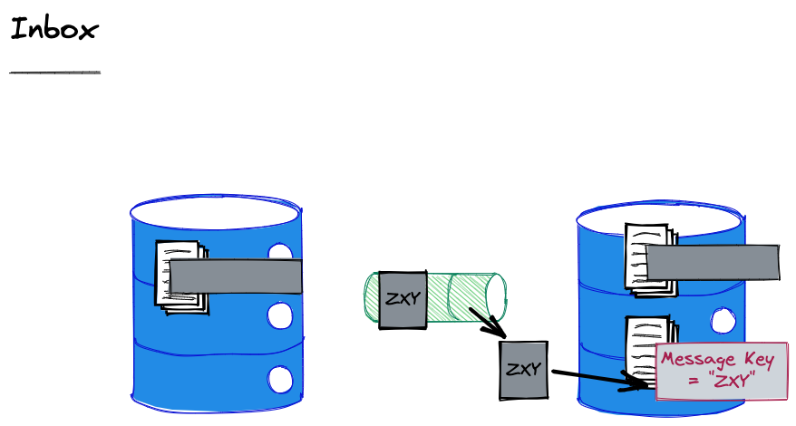
To ensure that we do not process a message twice, we record the ids of the messages that we have seen and discard duplicates.
Notes:
Defining Idempotence of Substantive Behavior
The processing of a message is idempotent if a subsequent execution of the processing does not perform a substantive change to the entity. This is an amorphous d efinition which leaves open to the application the specification of what is and what is not substantive. If a message does not change the invoked entity but only reads information, its processing is idempotent. We consider this to be true even if a log record describing the read is written. The log record is not substantive to the behaviour of the entity. The definition of what is and what is not substantive is application specific.

Slide 11
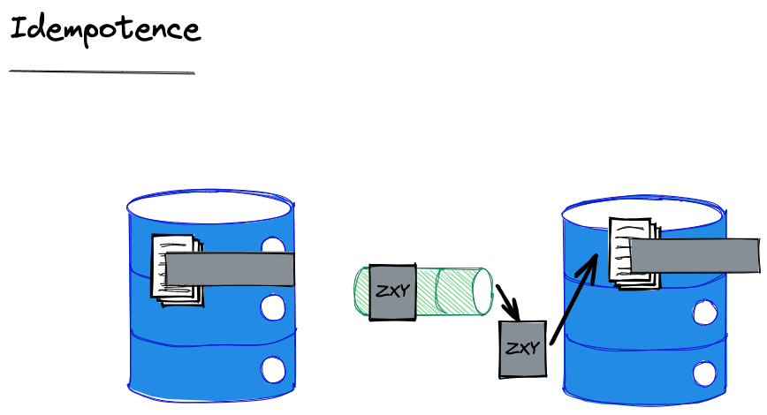
The alternative to an Inbox is idempotence. We say that a message is idempotent if reprocessing it does not carry substantive side effects.
Notes:
Substantive here is for the application to determine and is deliberately loose. But for example, writing a log would not be considered substantive in most cases.

Slide 12
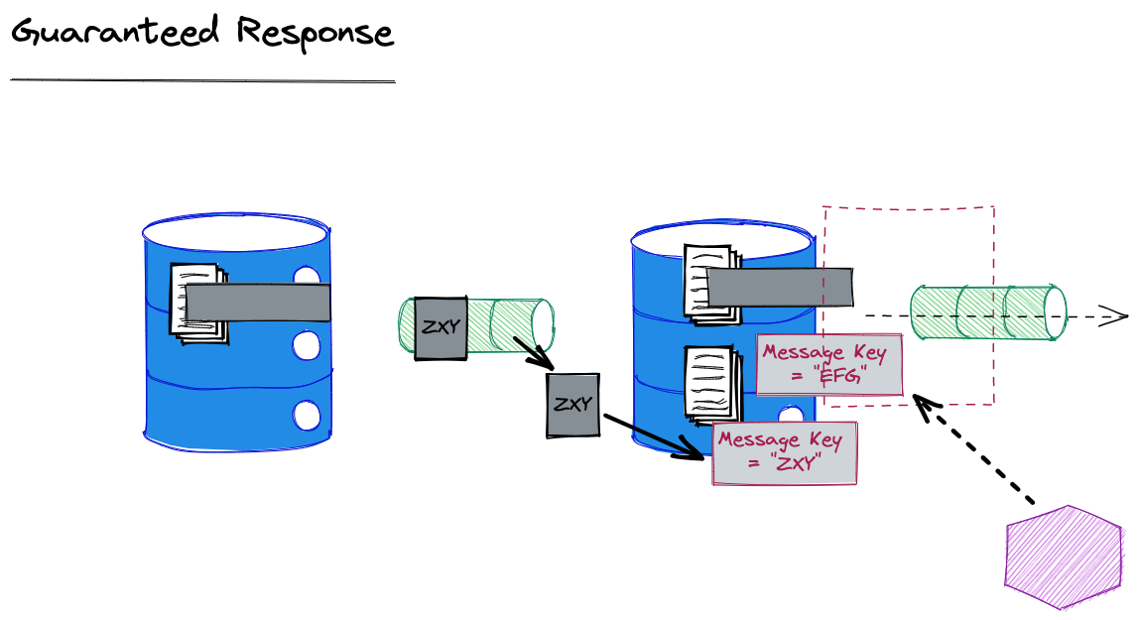
It is possible that we received a duplicate because our response was not received. We may choose to resend our response in that case.
We want to resend our original response.
By deleting the published timestamp in our outbox, we can get our outbox sweeper to resend it.
Notes:
In addition to remembering that a message has been processed, if a reply is required, the same reply must be returned. After all, we don’t know if the original sender has received the reply or not.

Slide 13
What happens if our Db does not support a transaction between our outbox and entity?
Notes:
Pat Helland says: “transactional enqueuing of messages is de rigueur” (actually referring to a message sent without the corresponding entity update at the source. But despite sneaking in this idea that there is a transaction around sending a message (and dequeuing a message – don’t ack until you have actioned) he does not describe how to achieve it within the limitations of “no 2PC”
If we have an activity that uses the same key as the entity we would get co-location and a transaction would be on the same cluster.
Note that if we use something like DynamoDb transactions don’t optimise for being on the same cluster node, they are just 2PC, so practically this is not necessarily a priority for most implementers

Slide 14
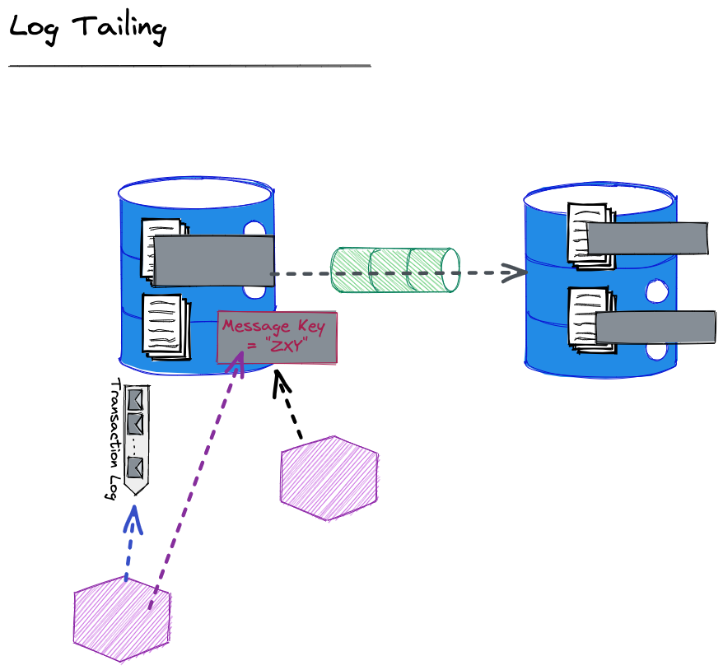
A Transaction Log is a stream representing the writes to the entity store
Then as before a worker looks for unsent messages in the outbox and sends them
A worker listens to the Transaction Log, and creates needed events, writing them to the outbox.

Slide 15
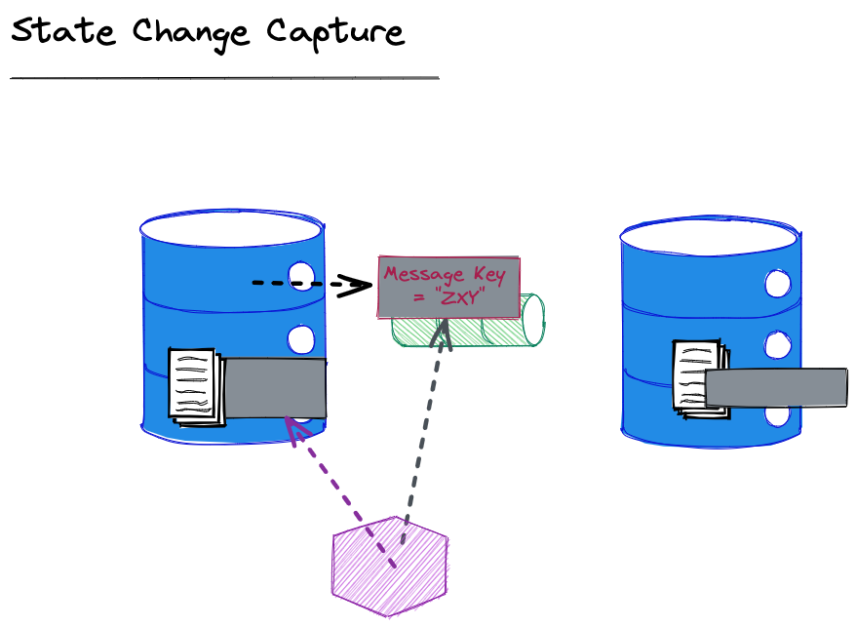
We raise the message before any corresponding write to an entity
On reading the message – we write to the origin entity

Slide 16
Agenda
T:50
Messaging: Outbox and Inbox
Brighter Example

Slide 17
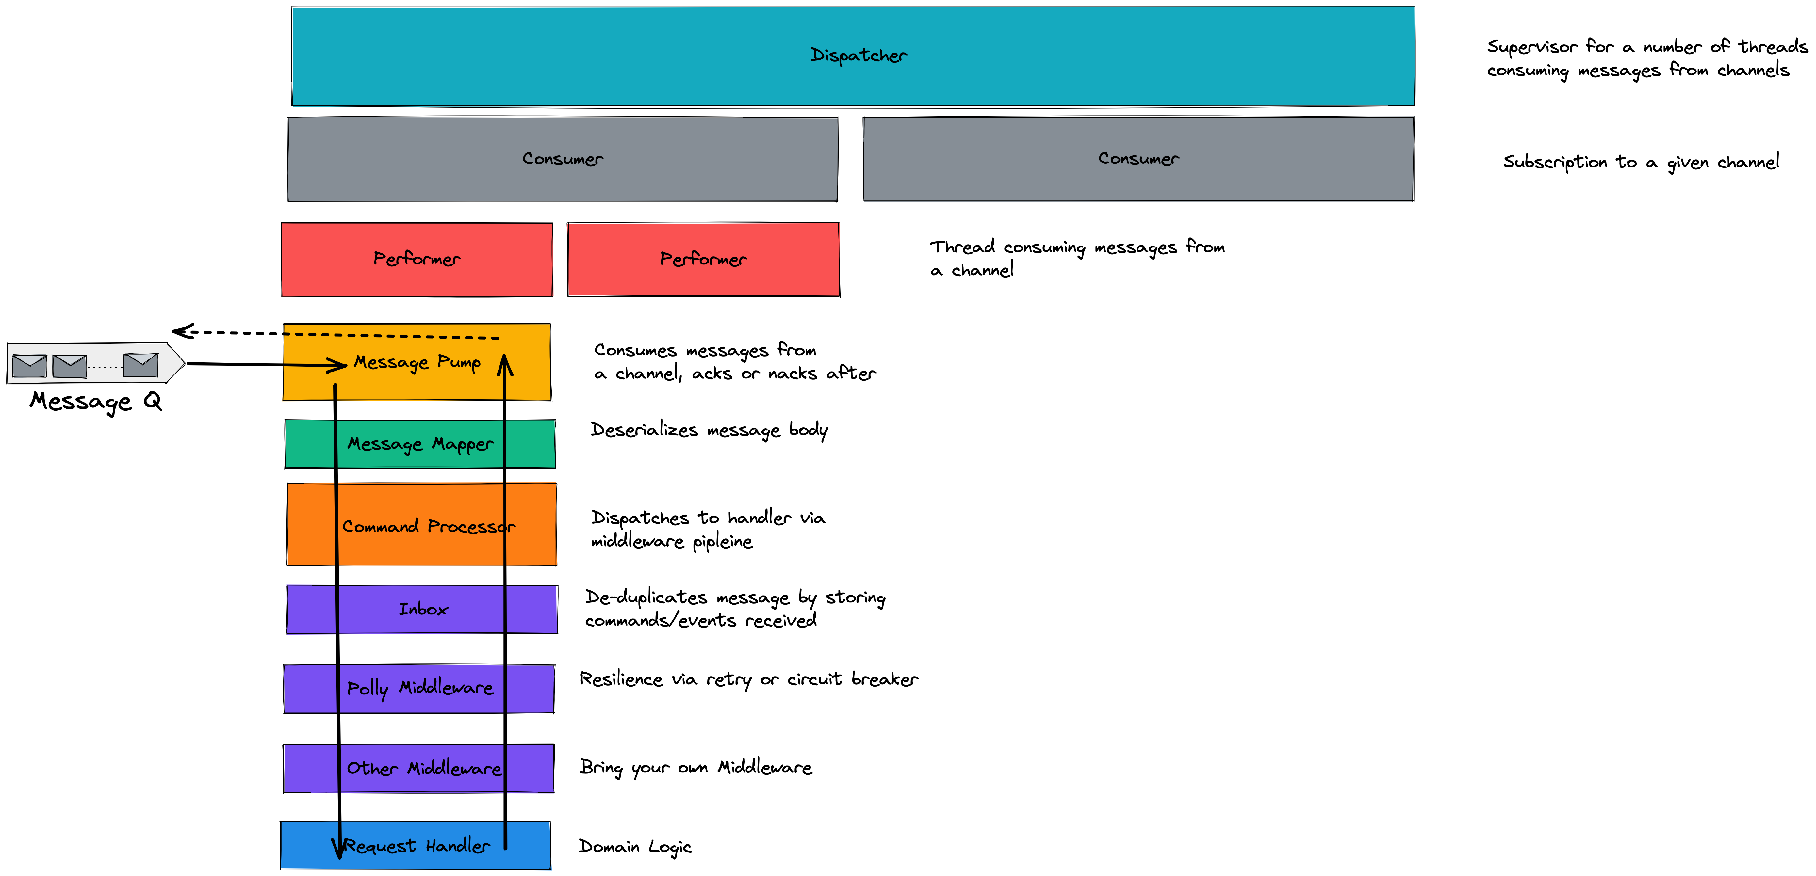
Brighter has a:
Message Pump that reads from a queue and dispatches to a middleware pipeline
Inbox in it’s pipeline
Handler that runs domain code

Slide 18
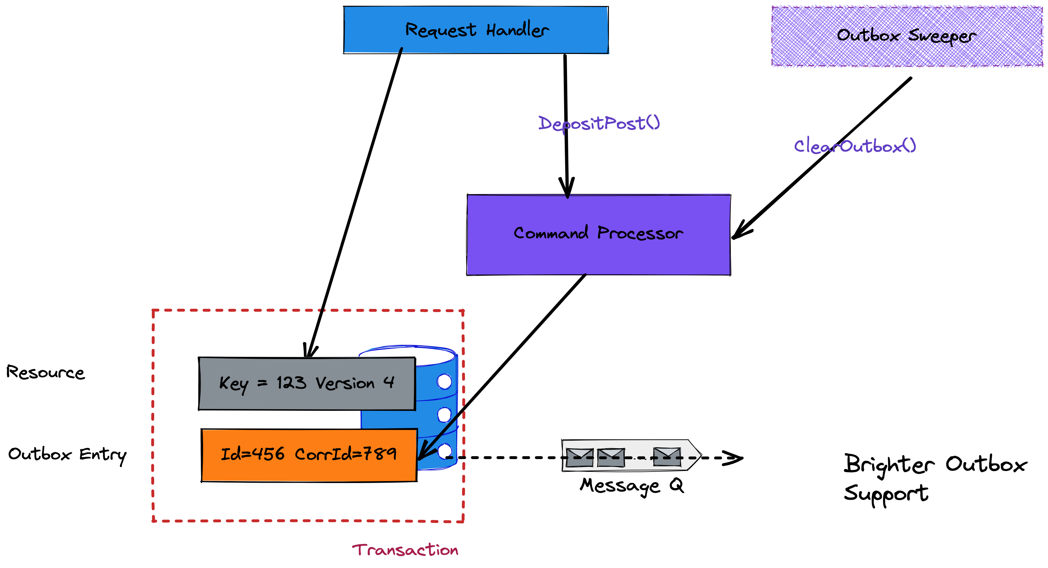
Within a transaction we:
Write a resource
Write a message to the Outbox
A separate thread
Flushes any unsent messages to the queue
Marks them as sent once broker confirms

Slide 19
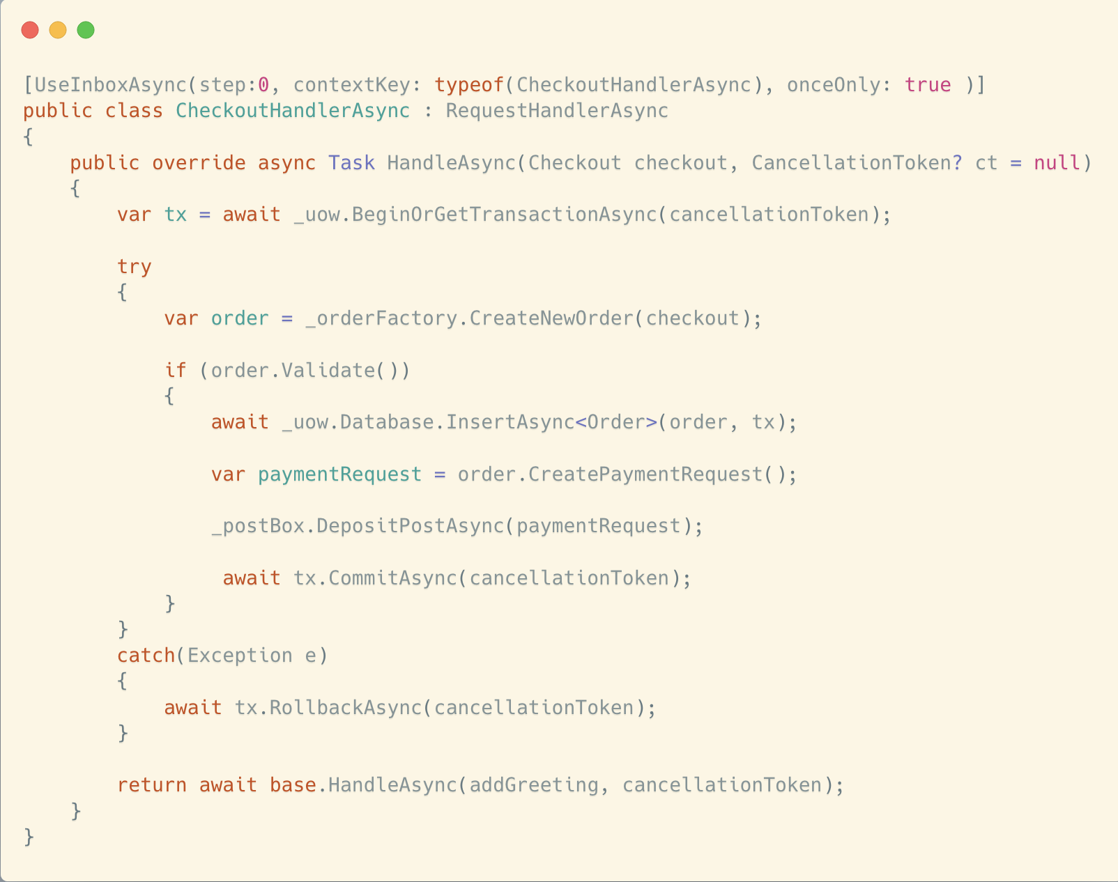

Slide 20
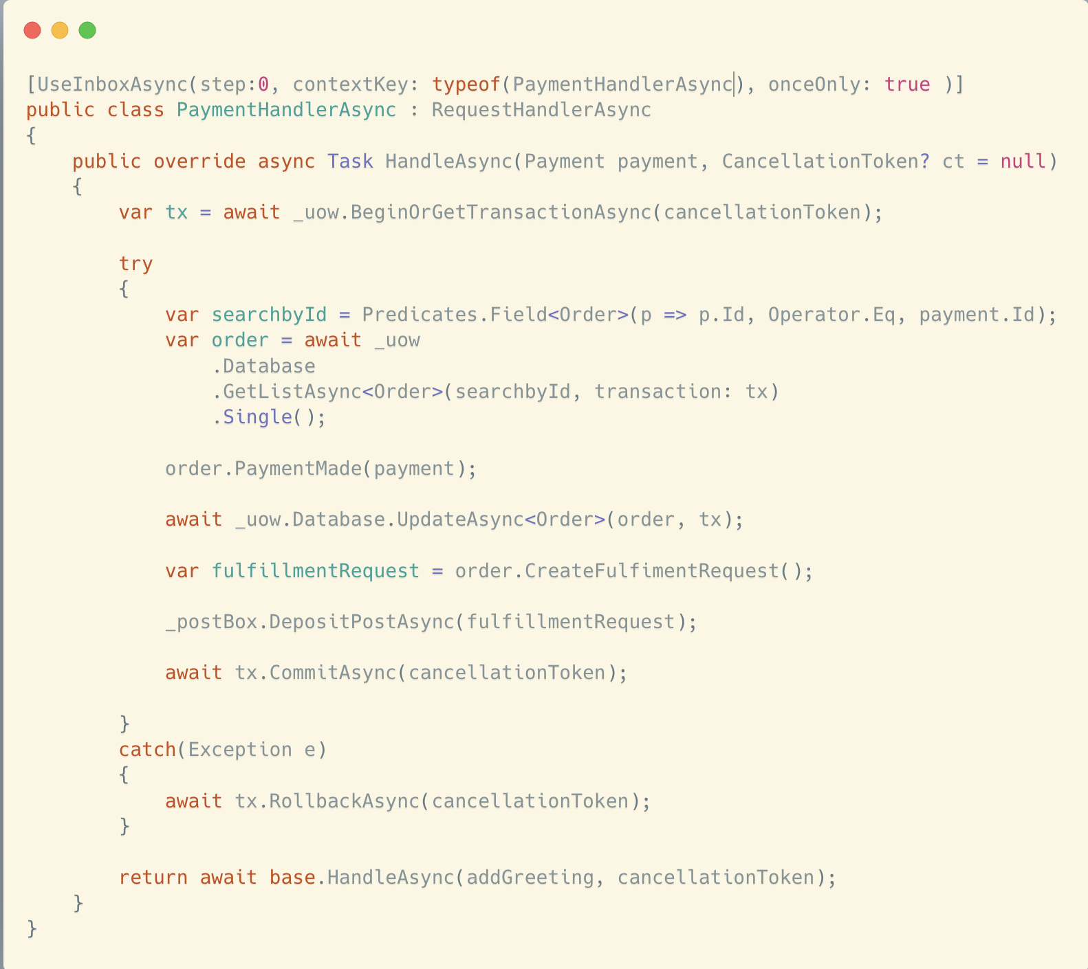

Slide 21
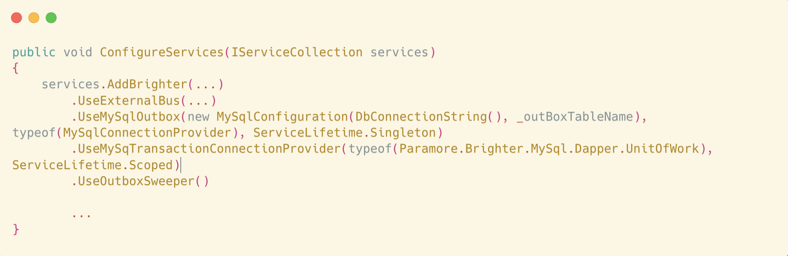

Slide 22
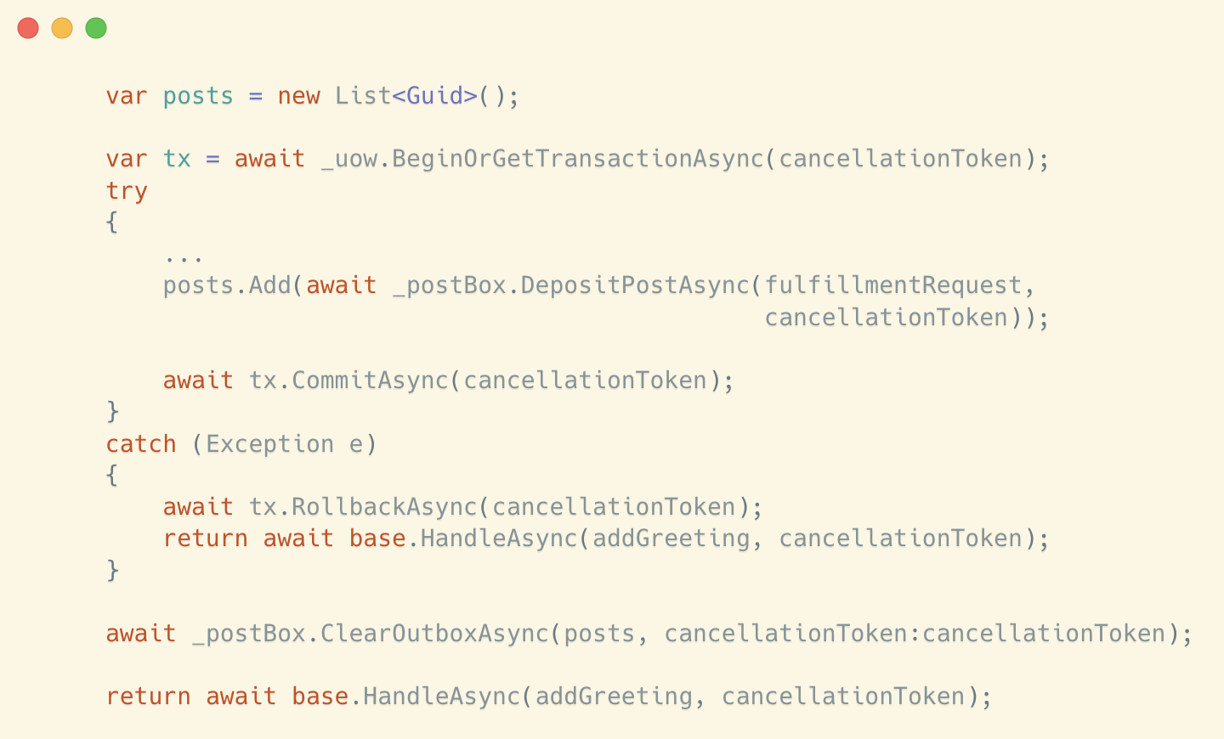

Slide 23
Agenda
Messaging: Outbox and Inbox
Brighter Example

Slide 24

END

